Slide 1





MACHINE LEARNING IN ENGINEERING SCIENCE
Music Genre Generation System
Start!
Group 12
E94101096劉翁碩
P86131183官廷昱
N16131722許志煒
N96131558林沛錡

Slide 2



Outline
1
2
3
4
Introduction
Method
Results
Conclusions

Slide 3
Introduction

Slide 4
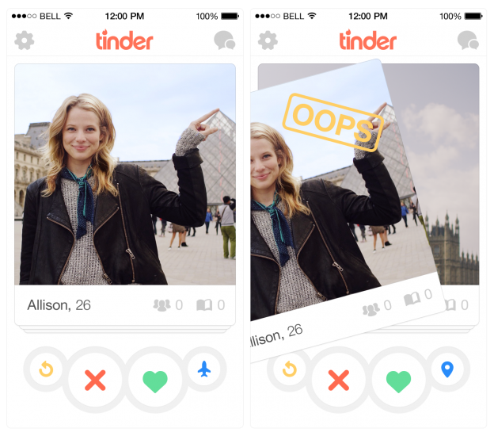
Background
In this age of information overload and endless choices, we’re often overwhelmed by the sheer number of songs available—and still don’t know what to listen to.
At the same time, Tinder has made finding a match simple and intuitive through its swipe-based interaction.
We began to wonder: What if we applied this same interaction model to music discovery?
Notes:
在這個資訊過載、選擇無窮的時代，我們常常被琳瑯滿目的歌曲所淹沒，卻仍然不知該聽哪首。
同時，Tinder 透過其基於滑動的互動方式，讓尋找配對變得簡單直覺。
我們不禁思考：如果將同樣的互動模式應用於音樂發現，會怎麼樣？

Slide 5
Background
This simple idea inspired us to create 聽der—a name that combines the Chinese word for “listen” - “聽” with the familiar experience of Tinder.
聽der is a swipe-based music discovery app where users explore short song clips with a single gesture—swipe left to skip, swipe right to like.
Based on your choices, the system learns your preferences and automatically builds a personalized playlist of songs you're likely to enjoy—ready for playback or download.
With 聽der, listening becomes more than passive streaming— it becomes a journey of connection, a chance to fall in love with music you never knew you needed.
Because sometimes, the perfect song doesn‘t need to be found. It finds you — just like a match on Tinder.
Start!
Notes:
這個簡單的想法啟發我們創造了「聽der」——這個名字將中文「聽」與Tinder的熟悉體驗相結合。「聽der」是一款基於滑動的音樂發現應用，用戶只需一個手勢即可瀏覽短歌片段——向左滑動跳過，向右滑動點讚。根據您的選擇，系統會學習您的偏好，並自動建立個人化的歌單，其中包含您可能喜歡的歌曲，可供播放或下載。有了“聽der”，聆聽不再只是被動地流媒體音樂——它變成了一段連接彼此的旅程，一個愛上從未想過自己需要的音樂的機會。因為有時候，完美的歌曲無需尋找。它會找到您——就像在Tinder上找到匹配對像一樣。

Slide 6
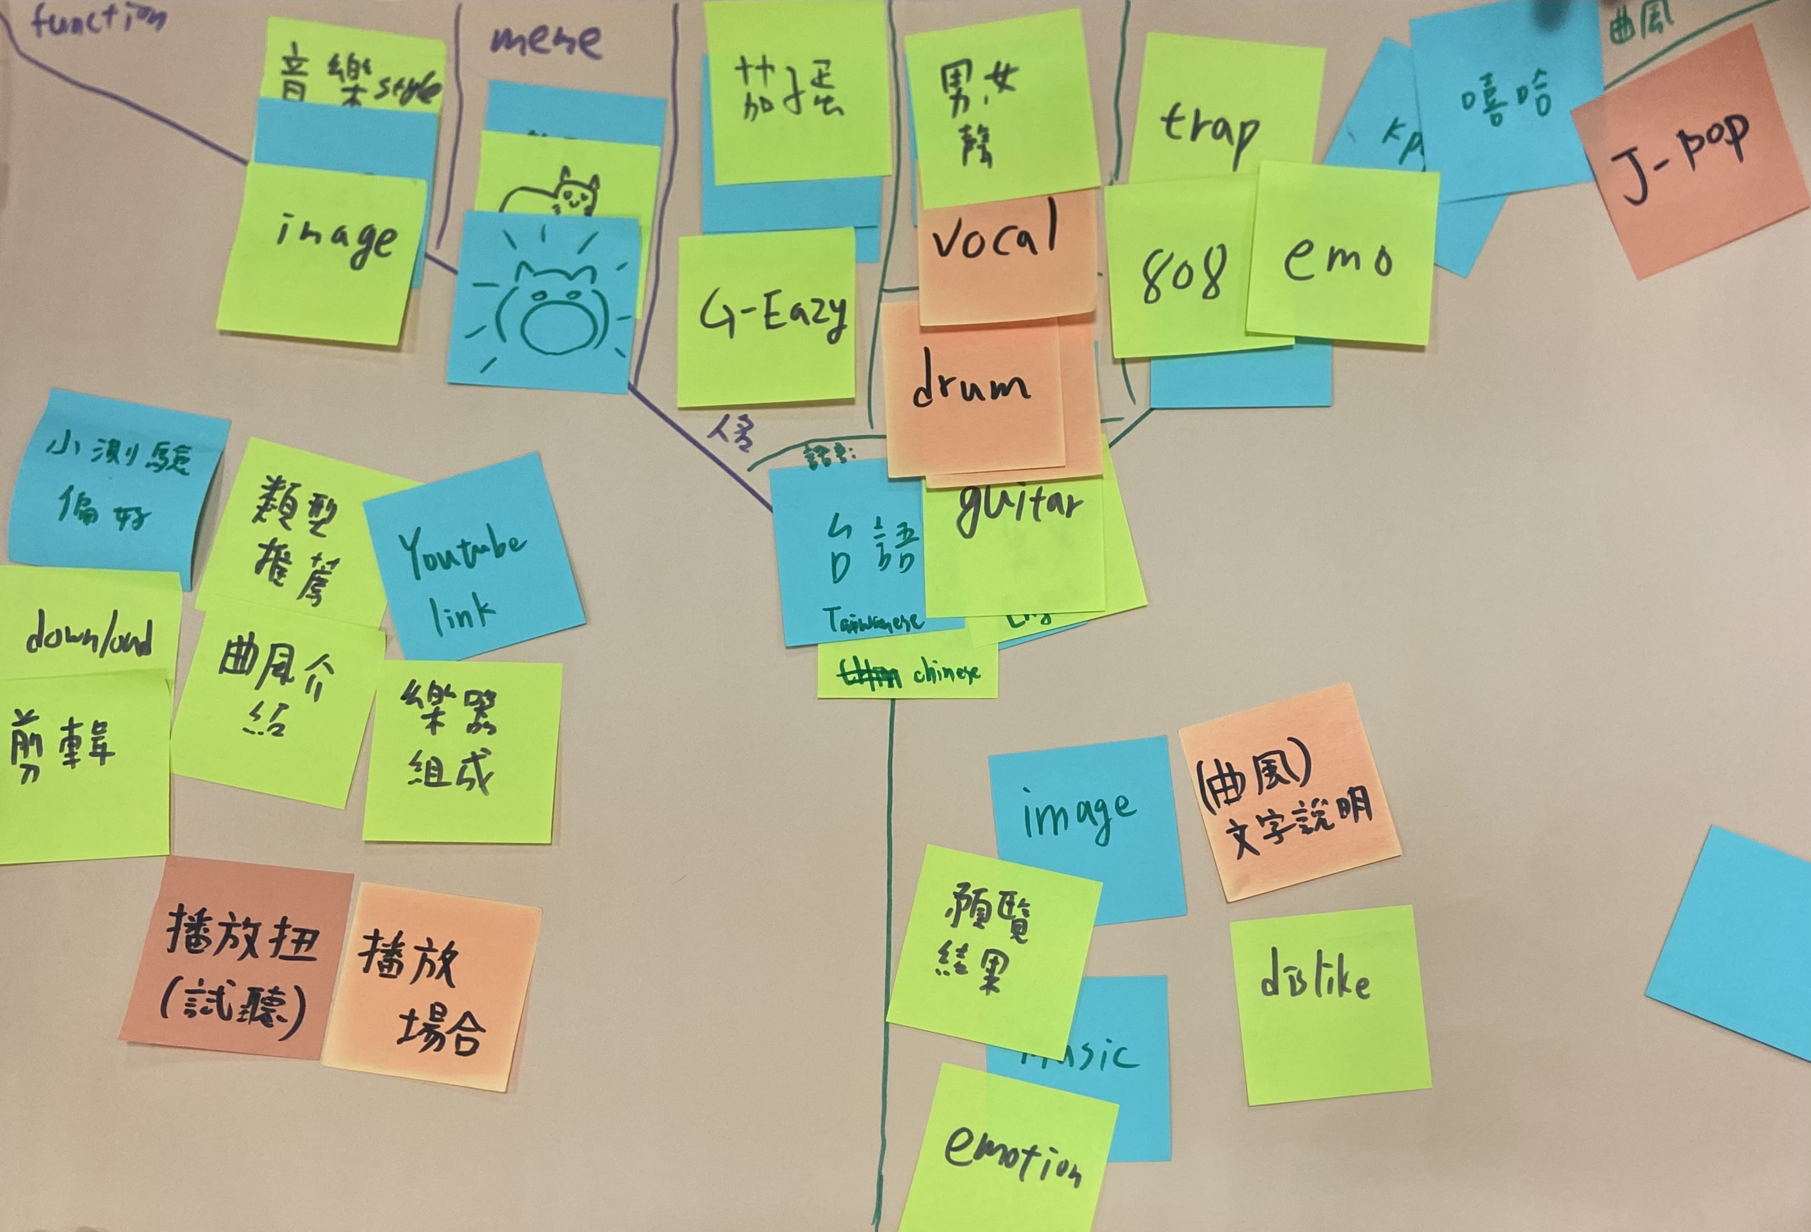
Workshop

Slide 7
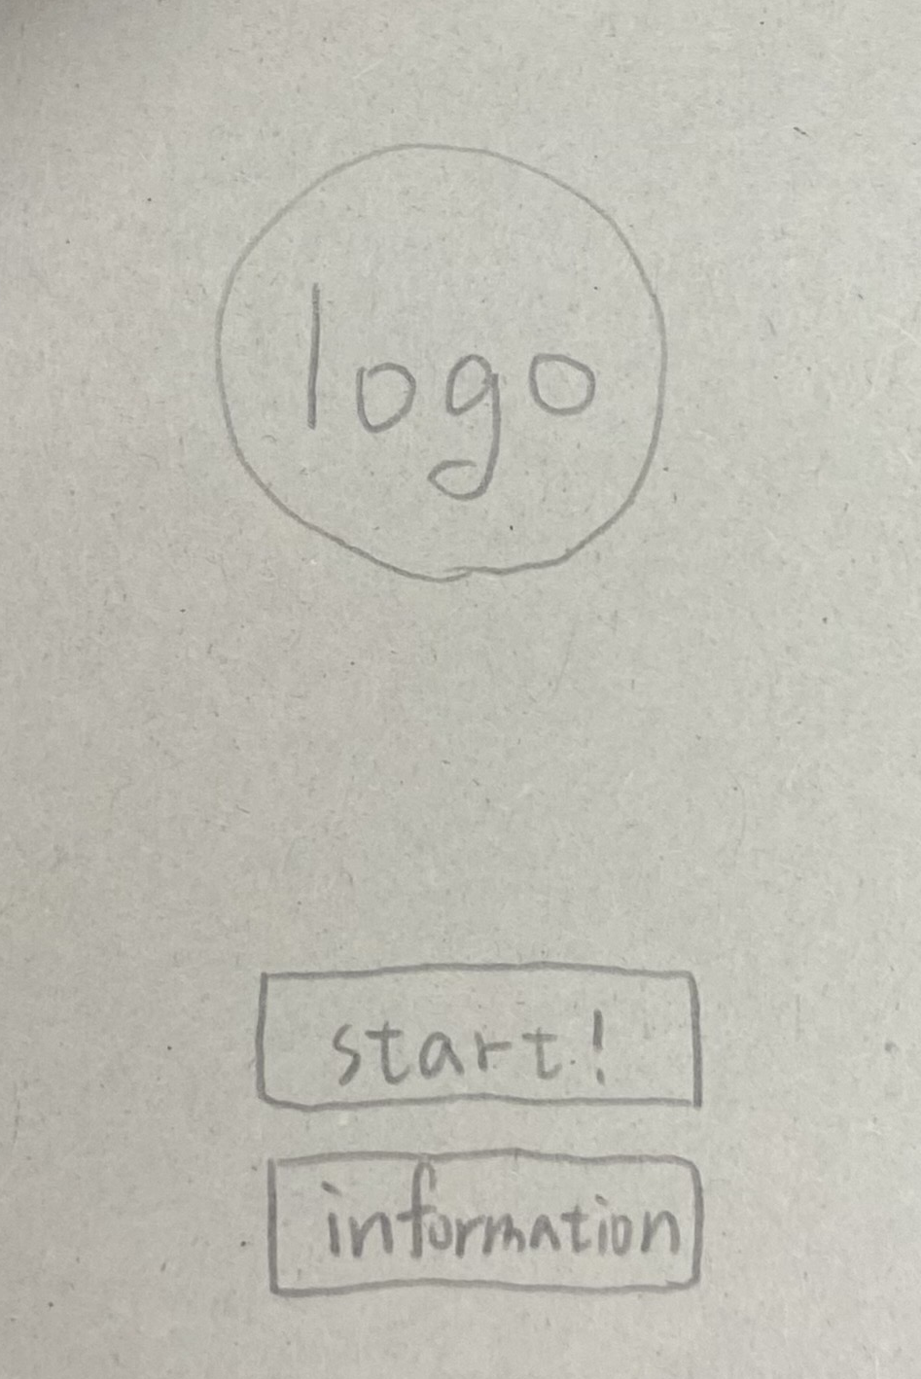
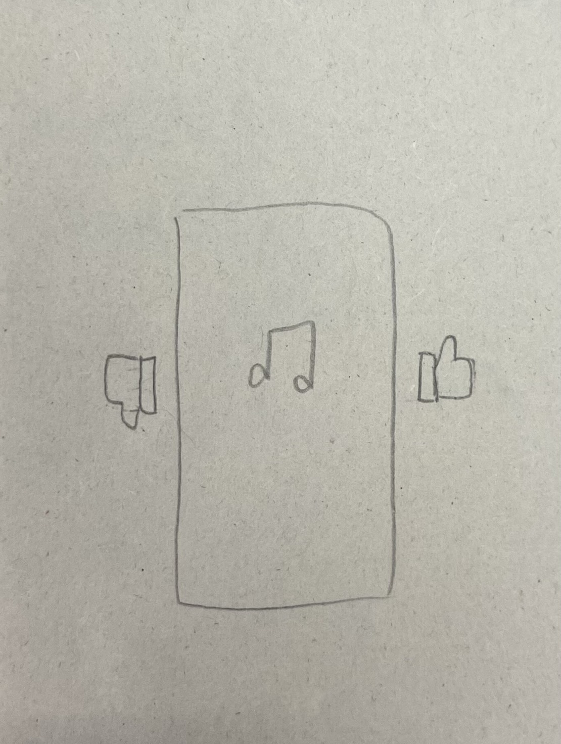
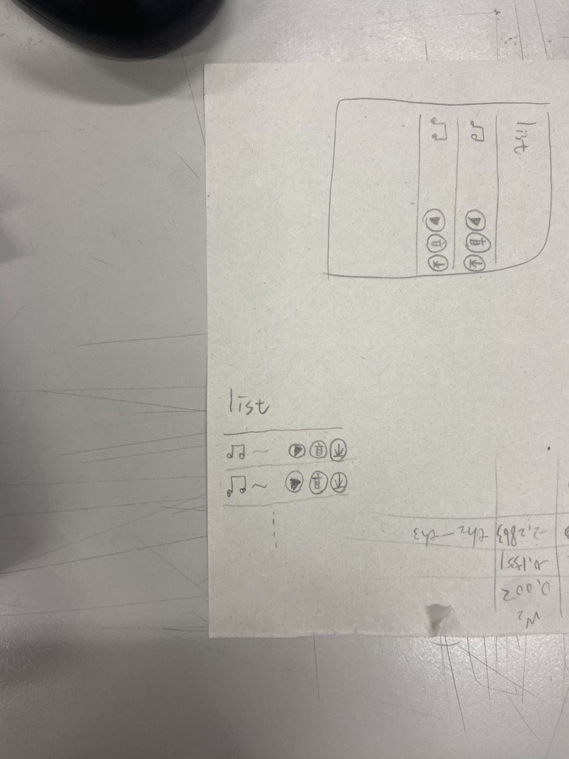
Workshop
Group 12:
Our program is called 聽der music
We are addressing a real-world issue related to decision fatigue in music selection due to overwhelming content choices.
We decompose the issue into several components such as user preference identification, swipe-based interaction, recommendation generation, and personalized playlist creation.
We map to user behavior inputs and feedback through the Al program’s recommendation system.
The goal of the Al program is to allow users to explore music in a fun, intuitive way and effortlessly connect with songs that truly match their personal taste.
Interaction Screen
Interaction Screen
Interaction Screen

Slide 8
Method

Slide 9
Data preprocessing
Audio (.wav)
CNN-ready Data
(Train / Validation / Test)
Cut into 2-second segments
Normalization → Split →
One-hot Encoding → Reshape
Segmented audio
extract_features()
Load into X, y
Save as .pkl file
Extract Mel + Chroma + MFCC → (1, 173, 89, 1)
All feature files

Slide 10
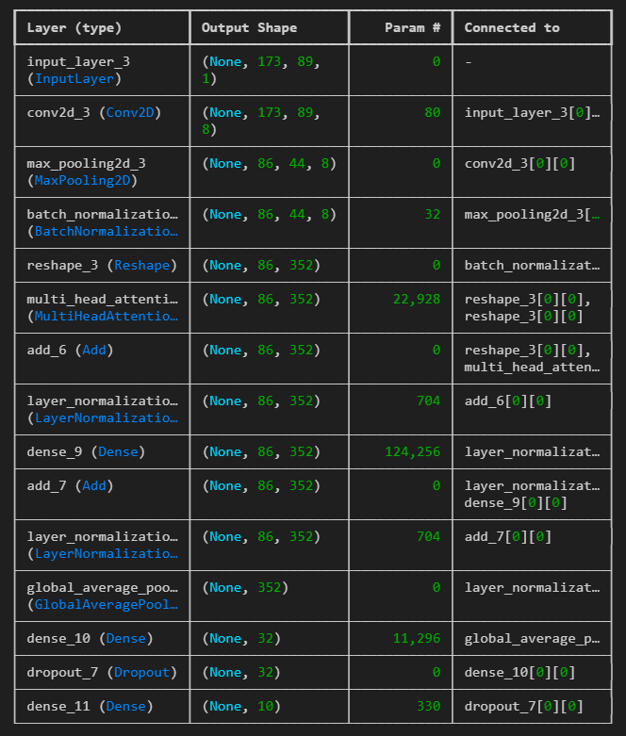

Model architecture
s

Slide 11
Result

Slide 12
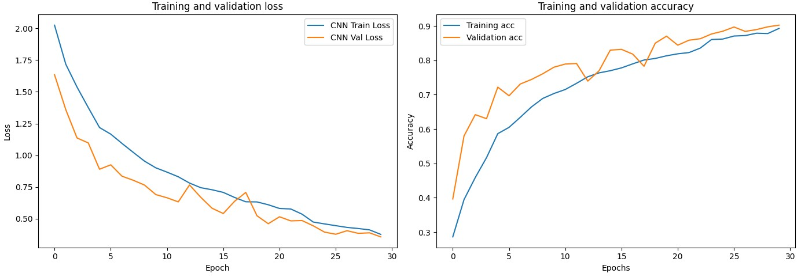
Training results
Test Accuracy(CNN):0.9082
Test Loss(CNN):0.3508

Slide 13
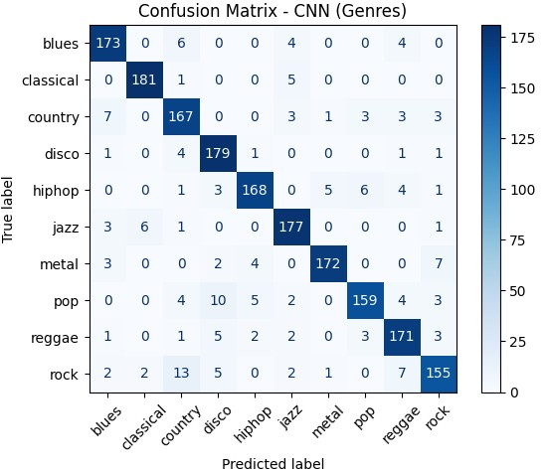
Training results

Slide 14
Prediction results

Slide 15
GUI Interface

Slide 16
Operation video

Slide 17
Github link

Slide 18
Conclusions

Slide 19
Conclusions
We’re pleased with the model’s performance: on a ten-genre music classification task, it achieved an average accuracy of 87%, and the confusion matrix demonstrates strong class-separation. To further improve, you might consider:
Incorporating traditional ML algorithms
Compare with ensemble methods such as Random Forest and XGBoost alongside your CNN to identify the best approach.
Enhancing feature engineering
In addition to Mel-spectrograms, extract features like MFCCs, chroma vectors, and tonnetz to enrich the input representation.
Model ensembling and hyperparameter tuning
Use ensemble strategies (e.g. soft-voting or weighted voting) and systematic hyperparameter searches (grid search or Bayesian optimization) to leverage complementary model strengths.
Expanding and augmenting the dataset
Add more diverse, longer audio samples or apply augmentation techniques (pitch shifting, time stretching, etc.) to boost generalization.
Implementing these steps should help you achieve higher accuracy and more robust performance in music genre classification.

Slide 20
Work Allocation
E94101096
劉翁碩
N16131722
許志煒
P86131183
官廷昱
N96131558
林沛錡
Model Training Code Implementation
Model Training Code Implementation
UI Design
Presentation Preparation

Slide 21



Thank
you

